Slide 1
Applying for Maths at Oxbridge
July 2016

Slide 2
Why study Maths?
You find maths interesting
You enjoy exploring new problems
You are good at maths
You want that investment banking money

Slide 3
Cambridge Application Procedure Outline
Submit UCAS application by 15th October
Complete the Supplementary Answer Questionnaire you are sent
Interviewed in the first half of December
Find out outcome in mid-January: Offer, Pooled, Rejection
Take the STEPs in June with A-Levels
The standard offer for Maths (G100) is A*A*A + 1 in STEP II & 1 in STEP III

Slide 4
Oxford Application Procedure Outline
Submit UCAS application by 15th October
Take the MAT in November
Interviewed in the first half of December
Find out outcome in mid-January: Offer, Pooled, Rejection
The standard offer for Maths (G100) is A*A*A

Slide 5
Criteria
The factors Oxbridge take into account when giving offers are:
GCSEs
AS level grades and UMS scores
Personal Statements
UCAS reference
Performance at Interviews
Performance on the MAT (for Oxford)
Each University and even each college gives different weightings to each factor but generally Year 12 UMS scores and Interview performance are the most significant.

Slide 6
Personal Statement
It is generally not very important for Maths, grades and interview performance are much more important
Extra-curricular activities are essentially irrelevant
Possible items to mention:
Maths Challenges if you have at least Gold
Maths society presentations you have done
Books you have read
Specialised lectures you have attended
Problems you have done that affected your interests/ability

Slide 7


Interviews
Cambridge: 1,2 or 3 interviews, 30 to 45 minutes each, all on one day
Oxford: 3 or more interviews over a 3 to 5 day stay at the college
Interviews almost exclusively consist of working through maths problems
Some colleges give tests on the day instead of interviews
They are examining your approach not your knowledge
Find
Sketch

Slide 8
STEP (Sixth Term Examination Paper)
The hardest part of any offer
There are three papers: STEP I, II and III, each 3 hours long - Cambridge ask for II and III, the marks are U, 3, 2, 1 and S.
Each paper consists of 13 questions: 8 Pure Mathematics, 3 Mechanics, 2 Statistics
Papers I and II are based on all of A-Level Mathematics (C1-C4, S1, S2, M1, M2)
Paper III is based on all Mathematics Modules (C1-4, FP1-3, S1-4, M1-5)
Paper II and III are considered to be the same difficulty; STEP I is considered easier than them

Slide 9
STEP (Sixth Term Examination Paper)
In each paper only your best 6 solutions are marked and little credit is given for ‘fragmentary answers’
Each question is out of 20
Typically 4 good solutions (i.e. not necessarily full) are enough for a 1
The mean grade for a 1 in STEP II is 68 and 62 in STEP III

Slide 10
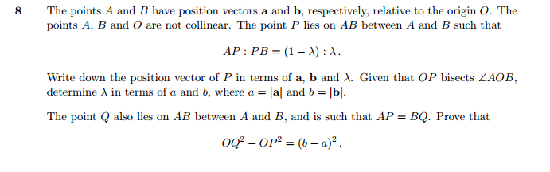
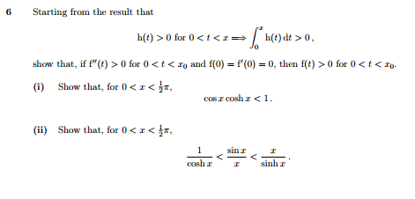
STEP (Sixth Term Examination Paper)

Slide 11
Maths and Physics
Cambridge have a Maths and Physics option - think carefully about applying to this
Applying to Maths and Physics (or Maths and Stats) at Warwick could be a safer insurance (as opposed to Maths at Warwick) as there is no STEP/AEA requirement and the standard offer is AAA
If you are applying to a non-Pure Maths course at another university (and applying to Maths at Cambridge), tailor your personal statement to it as it is likely matter more than for Cambridge

Slide 12
A-Level Permutations
The modules you should definitely take are all the Further Pure modules as well as either M3 or S3 depending on your preference. D1 may be a useful backup module but if you are not retaking any modules then a backup is not needed
Dropping your fourth subject definitely gives you more time to prepare for STEP but it is on a case by case basis and you should gauge the risk for yourself (our offers)
Taking M5 (though not necessarily M4 too) and S4 definitely gives you access to more questions but of course takes time - do not underestimate doing a whole extra module

Slide 13
A-Level Permutations
Keep your M1, M2, S1, S2 knowledge sharp as questions often require fundamentals
You may find it useful to quickly read through parts of FP2 and FP3 that are in the STEP specification that you have not yet learnt - do not stress over this though as you can work through STEP II before having this knowledge

Slide 14
Things for you
Maths wider reading resources on Topics
Maths interview questions on Topics
Maths personal statements on Topics
STEP information on Topics
Advice sheet on topics

